Slide 1
SOW
PG548 N2 EXITCODE[127] Troubleshooting
Presenter’s Name : Brian Gabriel A. Alban
Presenter’s Dept.: EDT220
2026/06/15

Slide 2
Background
Model: PG548
Function/Usage: Fixing the EXITCODE[127]
Purpose:
  Fix EXITCODE[127] issues during testing.
  Ensure reliable test results.
  Minimize downtime.
  Establish a clear troubleshooting process.

Slide 3
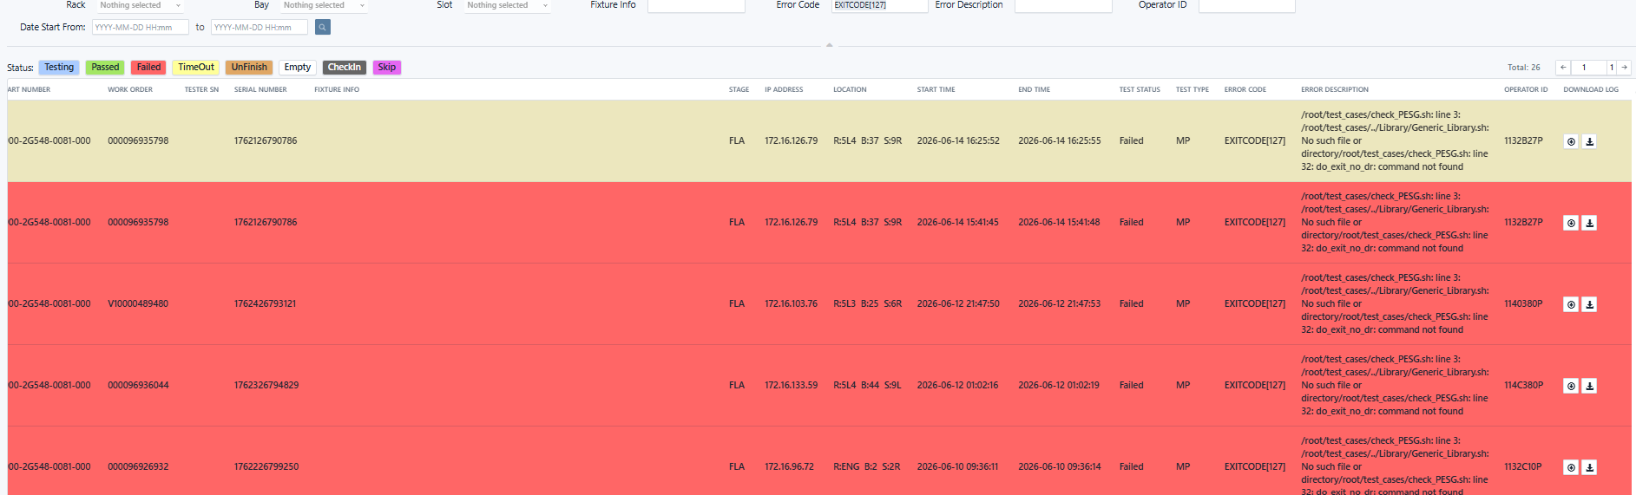
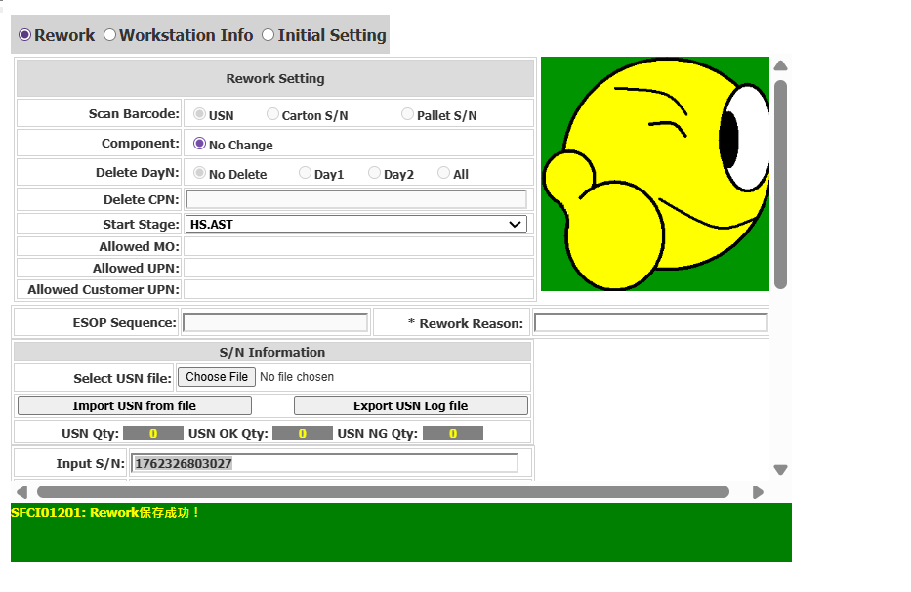
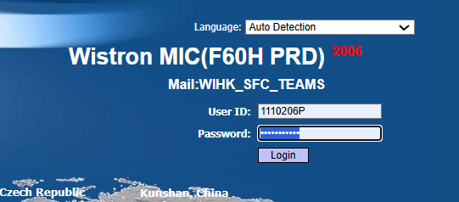
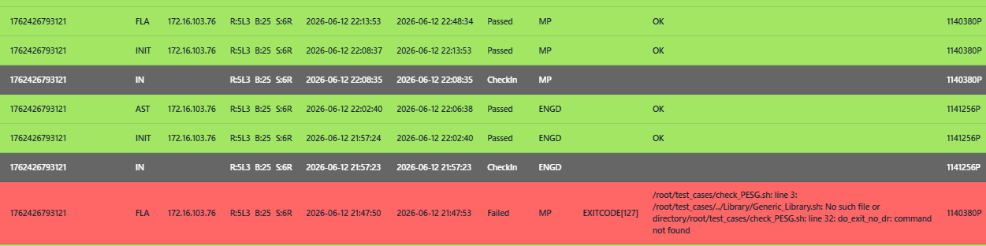
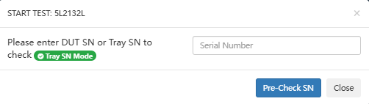
PG548 N2 EXITCODE[127] Troubleshooting SOW
Input | Process | Output
Failed Location in Fusioneye/Odin
Successfull Reroute Output
Start
Check failed location at Fusioneye/Odin
Login to MIC
CT: 3 mins
PIC: TE
Check out and reroute to 1st Stage
Retest
Passed Result in Fusioneye/Odin
Input Rework/Retest SN
Fail
Pass
TSC/PE/FAE Check & Debug/Repair
Testing Result?
CT: 5 mins
PIC: TE/TSC/PE
Retest
Input Retest Credentials
Go to Next Process (Endorse to PD)
End
PIC: TE
PIC: TE

Slide 4
Troubleshooting Process – Step-by-Step
Check Failed Location at Fusioneye/Odin:
  Identify the failed location in Fusioneye or Odin.
Check Stage in MIC:
  If the stage is FLA above please Reroute or back to 1st Stage.
  If the stage is already 1st Stage directly Retest
Retest DUT:
  Once the Stage is ok directly retest and wait result if will pass the FLA or if will fail
Go to the Next Process
  If still failed:
    Endorse the DUT TSC or FAE Repair then Retest if done repair.
  If result pass:
    Endorse the DUT to PD the next process.

Slide 5
Thank You!

Slide 6
Thank You!

